Slide 1
“Dishes Nutrition’s” Data Analysis Project” GitHub Link for Dashboard:- https://github.com/hemantg111/Knovator_Assignment.git
By
Hemant Gupta LinkedIn- https://www.linkedin.com/in/hemant-gupta-4914baa6

Slide 2
Dashboard Overview
This Power BI dashboard provides a comprehensive analysis of the nutritional content of various dishes, focusing on key metrics such as protein, fat, calories, sodium, and ratings.
The data allows us to understand how dishes are distributed based on their nutritional value and ratings, offering insights into which dishes are healthier or higher in certain nutrients.
Key visuals included in the dashboard:
Multi-Row Cards: Display the average nutritional values for protein, fat, calories, and sodium across all dishes.
Donut Chart: Shows the distribution of dishes based on protein categories (low, average, high).
Column Chart: Highlights the top 5 dishes by protein content.
Table: Lists the dish titles along with detailed nutritional values, including protein, calories, fat, sodium, and ratings.
Slicers: Enable filtering of data by specific dish titles, protein categories, ratings, calorie categories, and a special filter for "Cake Week" dishes.
This dashboard provides actionable insights into the nutritional makeup of dishes, helping users identify options that meet specific dietary preferences.

Slide 3
Steps Taken to Analyze the Recipe Data
Understanding the Problem:
The task involves analyzing the recipe data based on various parameters to retrieve actionable insights from the dataset.
Data Collection:
Collected raw data in the form of a CSV file.
Export the data into Power BI Desktop using the ‘Get Data' option.
Data Cleaning:
The raw data contained issues such as null values, unnecessary data, duplicate entries, and blank data fields.
Performed data cleaning by using Power Query Editor.
Loaded the cleaned data into Power BI Desktop to create visuals based on the specified parameters.
Data Analysis:
Created visuals, including Bar Chart, Donut Chart, Table, Slicers, to analyze the data.
Identified trends and extracted insights from the visuals data.
Interpreting Results:
Derived insights from the visuals.
Compiled a final report detailing the data analysis findings.

Slide 4
Total Dishes and Nutritional Summary
Visualization Type:- Multi Row Card
Insights:- This chart displays the Total Dishes and their Avg Nutritional Value.
There are 20,052 dishes analyzed.
Average calories per dish are 5,025.
Average fat content is 347, while protein averages 100.13, and sodium 4,947.06.

Slide 5
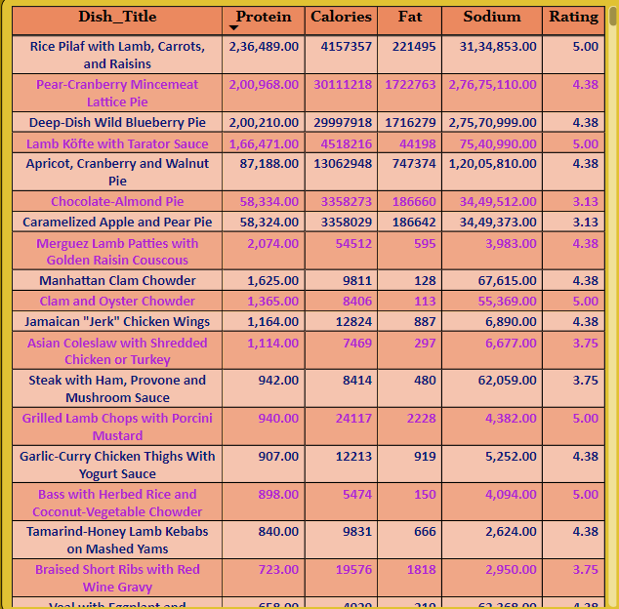
Table Visual
Insights:- In this Power BI dashboard, the Table Visual is used to display detailed information for each dish, allowing for easy comparison across multiple nutritional metrics. Here's how the Table Visual is used in the dashboard:
Comparative View: The table provides a side-by-side comparison of various dishes based on their nutritional values, making it easier for users to spot dishes that are high or low in specific nutrients.
Sortable and Searchable: The table allows users to search for specific dishes or sort by any of the columns (e.g., finding the highest-protein dishes or the lowest-calorie options).

Slide 6
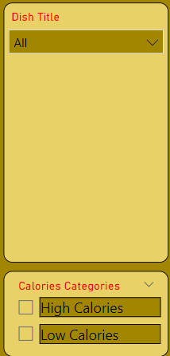
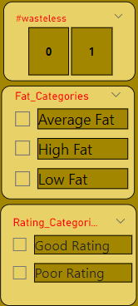
Slicers / Filters
The table works in conjunction with slicers (for filtering by protein, fat, calorie categories, etc.). When a filter is applied, the table updates dynamically, showing only the dishes that meet the selected criteria.

Slide 7
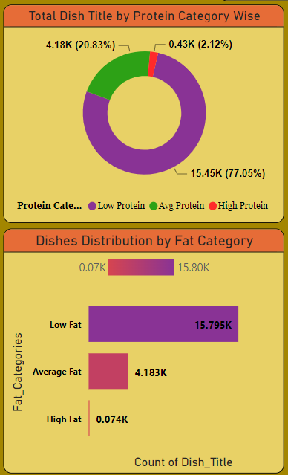
Dishes Distribution by Protein and Fat Category
Protein Distribution:
Majority of dishes fall under the "High Protein" category (15.45K dishes, 77.05%).
Only 2.12% of dishes have low protein content (0.43K).
A substantial portion of dishes has "Average Protein" (4.18K dishes, 20.83%).
Fat Category Distribution:
Most dishes have "Low Fat" (15.80K dishes).
A small number of dishes (0.07K) fall in the "High Fat" category, with 4.18K in the "Average Fat" category.

Slide 8
Conclusion
Title: Conclusion and Key Takeaways:-
The majority of dishes analyzed have high protein and low fat.
The top protein dishes include Rice Pilaf and Pear-Cranberry Pie.
Dishes can be analyzed further by categories like fat, calories, and ratings to suit different dietary needs.

Slide 9
Thank You

